Slide 1
IBM HACK
Identification of User Query on Stack Overflow using Semantic Search

Slide 2

Team Name - The Maverick
Team Size: 1
Team Member Name: Rohit Agrawal
Role and Expertise:
Algorithm Creation using Deep Learning
Creation of the web interface and the backend server
UI Design

Slide 3
The problem at hand
Stackoverflow consists of an abundant amount of information in the format of questions and answers thus making it hard to find the exact information you need for your project.
It is much easier for a domain expert to navigate through this mess because they know exactly what they are looking for.
However, a new programmer might get intimidated. For instance, if he needs to learn ‘how to make a server’ using Python, it is quite unlikely that he would use the terms ‘Django’ or ‘Flask’ in the search box.

Slide 4
How would it help their business
A major source of income for Stack Overflow is through Ad Revenue. Therefore, their goal is to maximize readership in order to push more ads, and earn thus more money.
Due to poor performance of their search system, a user would have difficulty getting his doubts cleared through their website and would thus decide to use a more sophisticated search engine like Google for their purposes. The problem arises when Google suggests them a resource other than Stackoverflow. For every user that leaves their website, they lose money they could potentially make.

Slide 5
A Possible Solution...
What we want is for the platform to actually understand the semantics of what the user is trying to search for, and then return the most helpful results for him
Natural Language Processing (NLP) has come a long way since its inception in the 20th century. We decided to use this subfield of Artificial Intelligence in order to solve our problem. NLP has proven to work very well in the past few years due to fast processors and sophisticated model architectures

Slide 6
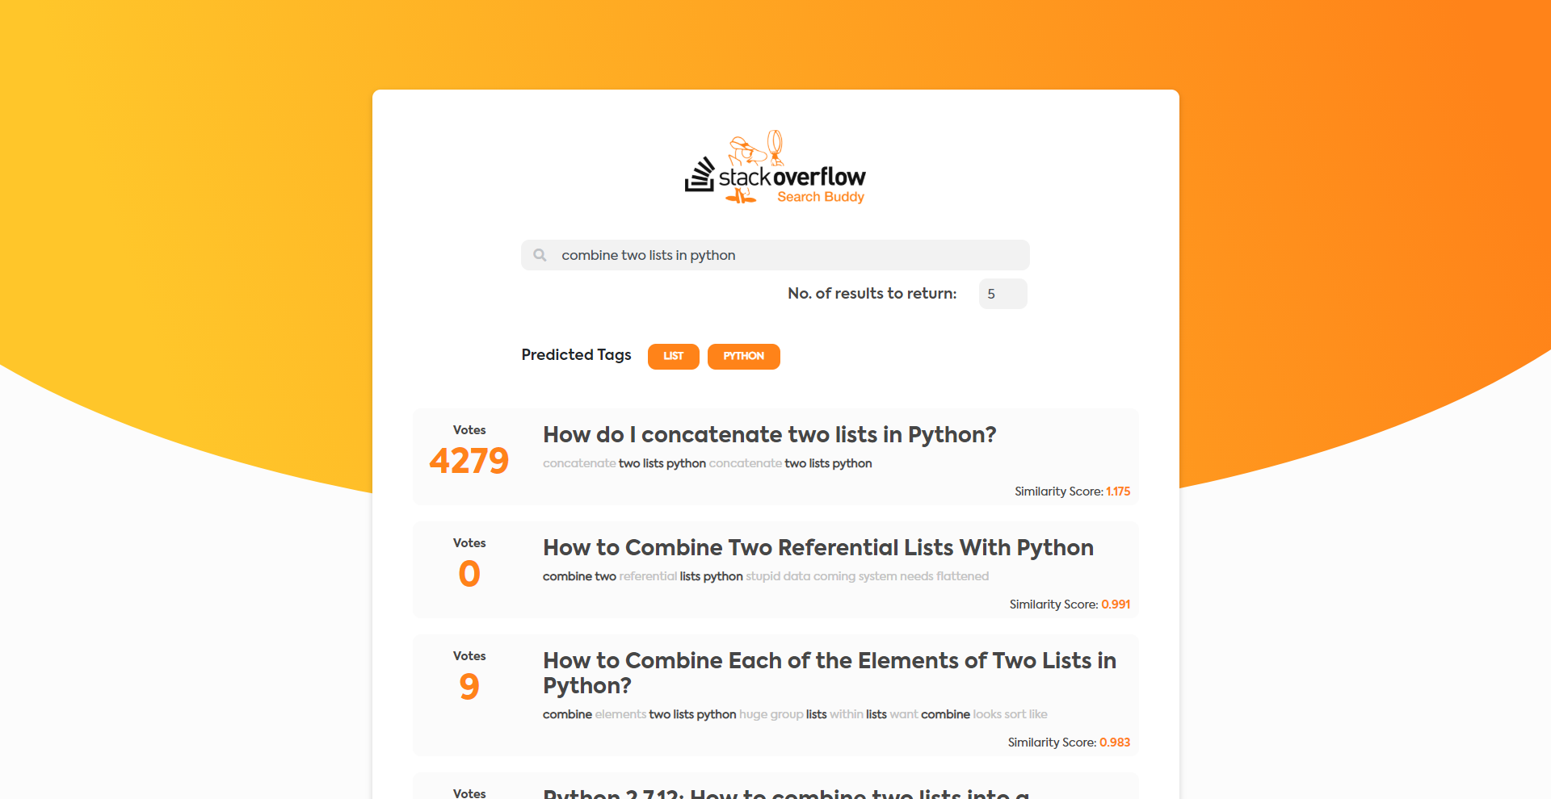
Example of the working solution

Slide 7
Overview of the proposed solution

Slide 8
Constraints for the project
Given the vast amount of data given on Stack overflow, I decided to exercise a few constraints for the proof of concept:
I have restricted the data to only Python Related Questions
I have restricted the possible tags to 500
I have used somewhat lower amounts of data points (~140,000) for faster processing
Since this project is mostly just a proof of concept, The web interface makes consecutive API calls to the server. This is not optimal for a production environment, and has only been added for visual aesthetic.

Slide 9
Technologies used
The final solution is a Web application which is a combination of the following:
A Deep learning model for classification of tags (written in Python):
Pre-processing for the data: nltk, spacy and pandas
Data preparation for the model: sklearn, keras
The model definition and training: keras
Semantic similarity calculation: sklearn
A visually aesthetic front-end (written in ReactJS):
Structure and logic: ReactJS and Javascript
Styling: Bootstrap and CSS
A server backend for serving the deep learning algorithm (written in Python):
Server creation and API Gateways: Flask
Model Serving: Tensorflow

Slide 10
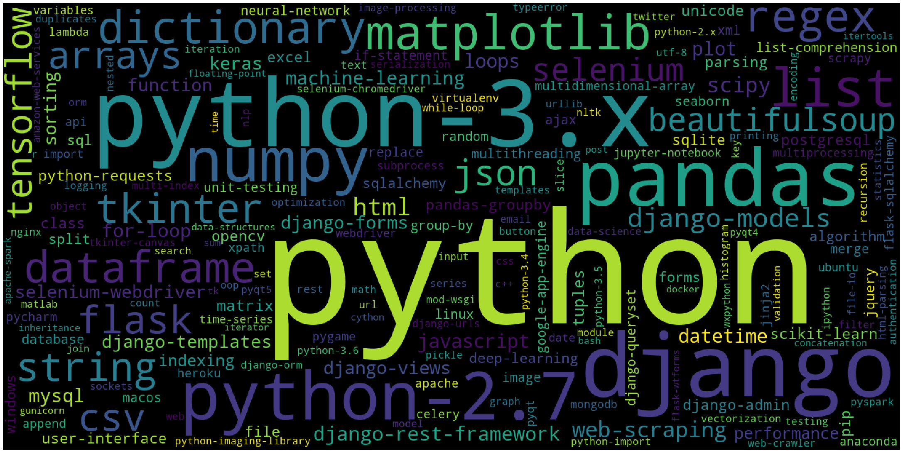
Most commonly occurring tags

Slide 11
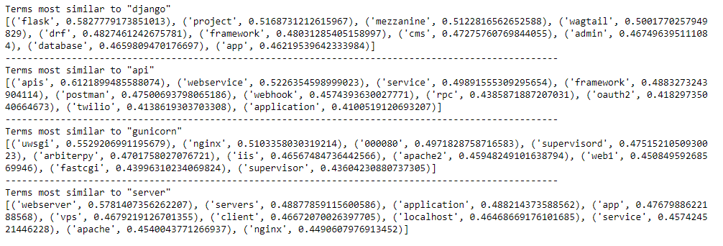
Sanity Checks on the trained Word Embeddings

Slide 12
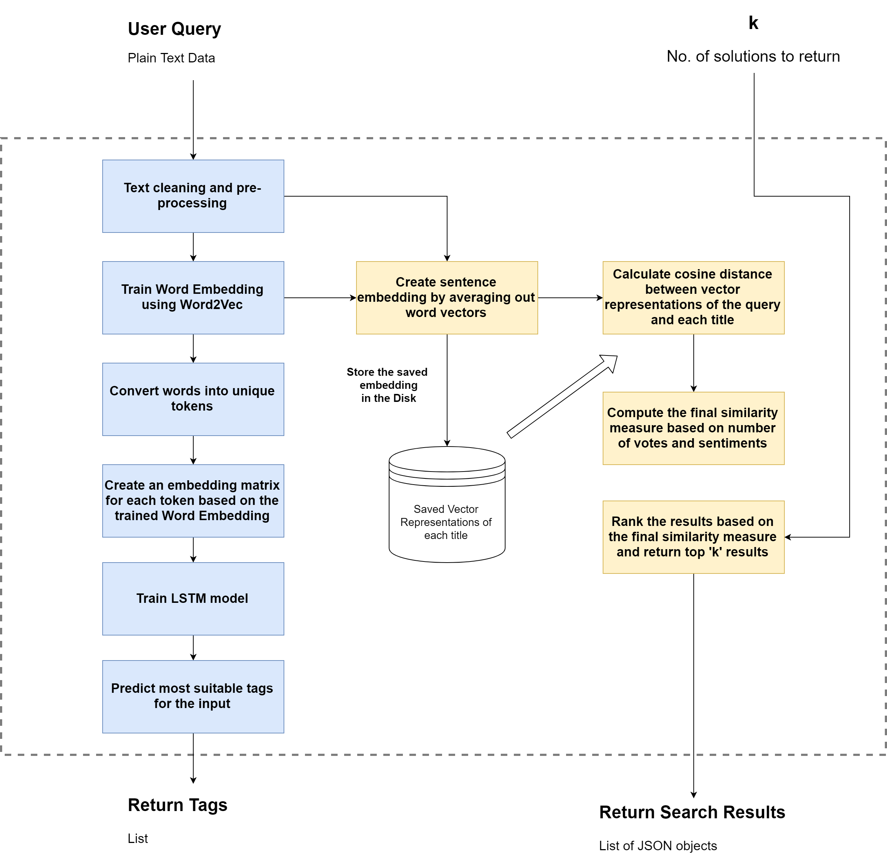
The Brain
The flow diagram given on the right is the crux of the solution.
It uses the concept of Word Embedding to extract features from raw text and then compare their similarity based on their distance from each other in their shared vector space

Slide 13
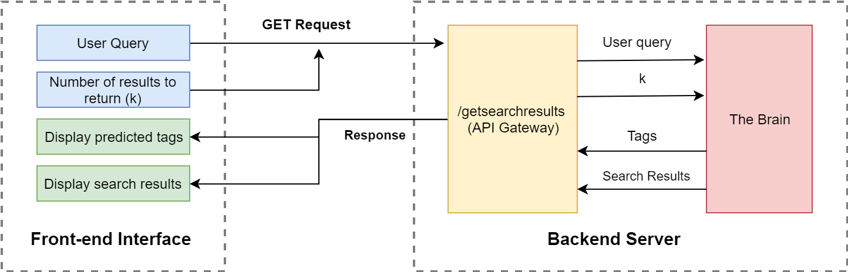
The Application Architecture

Slide 14
UI Design and Branding of the App

Slide 15
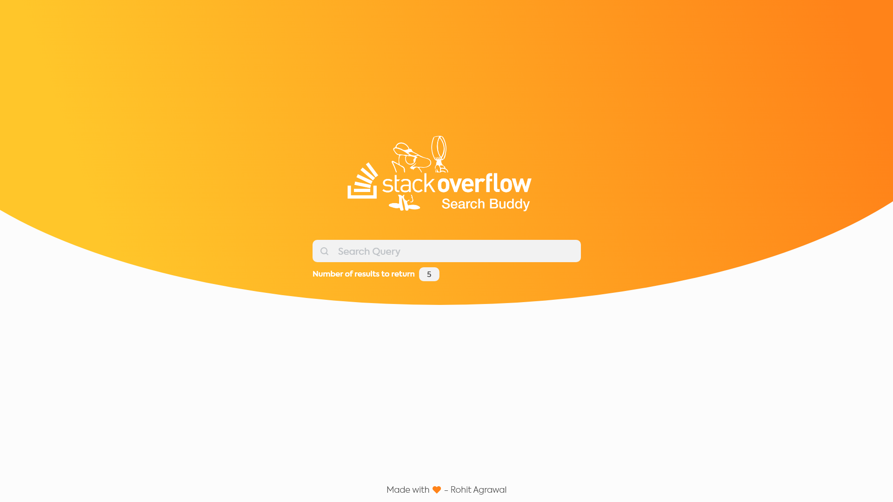
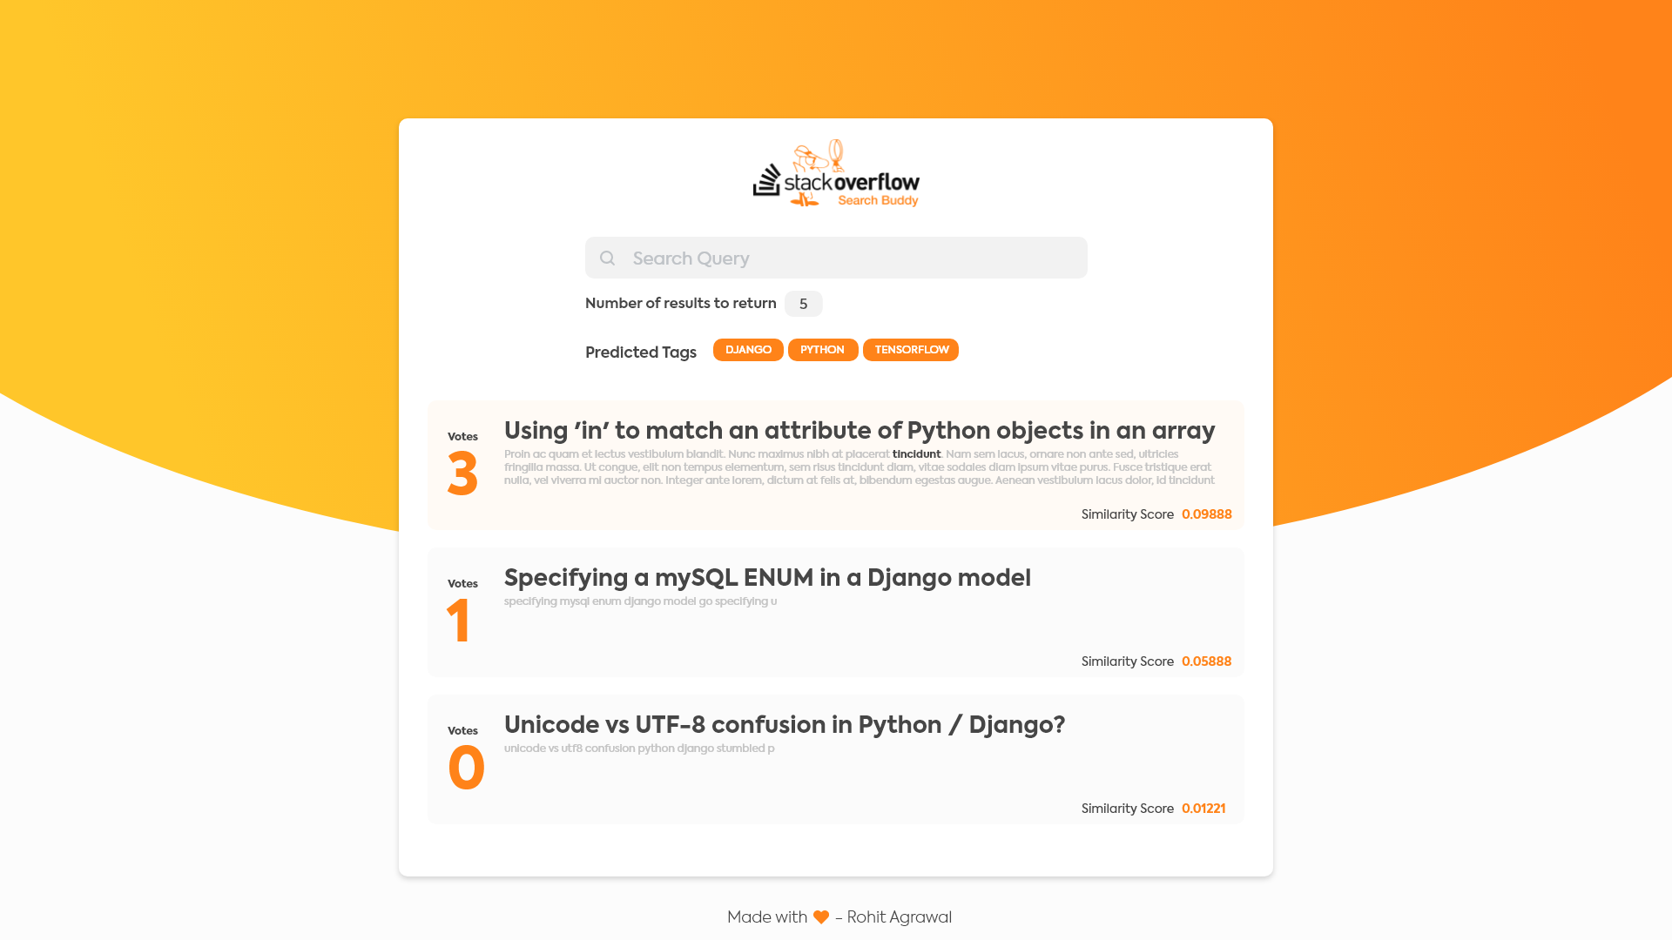
Final UI
I wanted to execute a minimalistic UI with the color scheme that synchronises with StackOverflow’s general theme

Slide 16
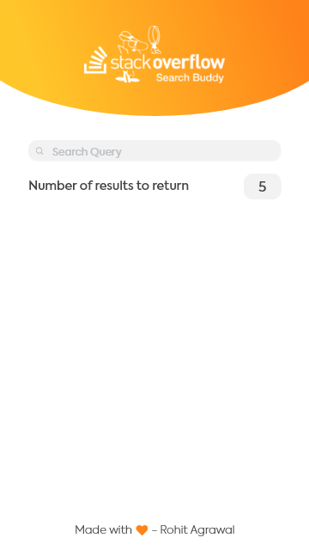
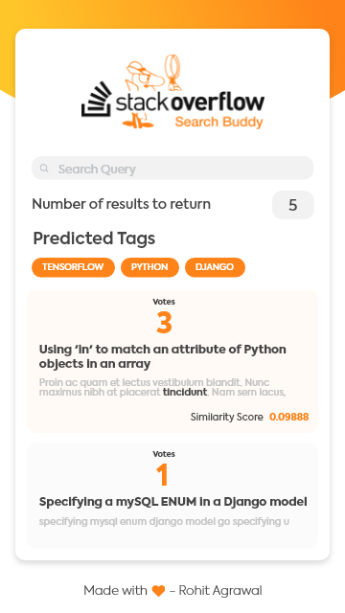
Final UI
The design is completely responsive and works very well for handheld devices as well

Slide 17
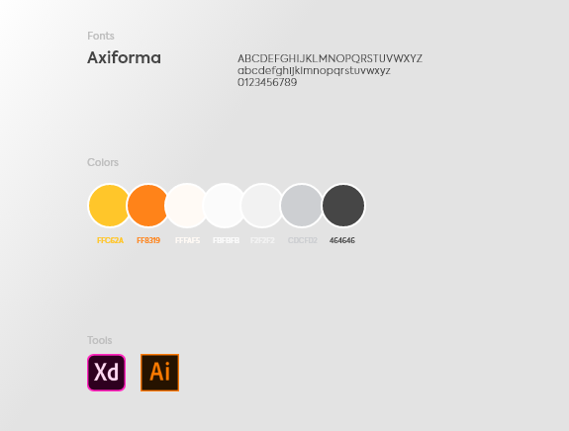
Design Guide

Slide 18



Logo Branding
The application was named ‘StackOverflow Search Buddy’, simply because that is what it exactly is.
It helps sift through the noise and finds the best information for you

Slide 19
Thank You!

